Slide 1
Process Mining Practice Session
Process Intelligence with the Signavio® Process Manager

Slide 2
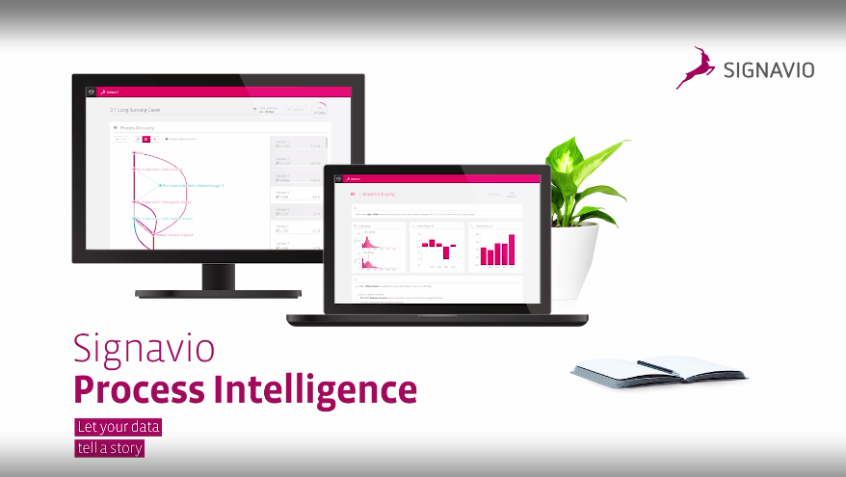
Overview

Slide 3

Content
Purpose of PI
Application Scenarios
Training Goal
Training Preparation
Signavio® PI Dashboard
Widget Types
Process Discovery
Process Variants
Process Conformance
Practice Exercises

Slide 4
1. Purpose of Process Intelligence (aka mining)
Process Extension / Enhancement
Process Conformance / Compliance
Process Discovery / Analysis
Identify causes of poorly performing processes (discovery/analysis)
Detect and visualize compliance violations (compliance/conformance)
Monitor performance and act on bottlenecks (extension/enhancement)

Slide 5


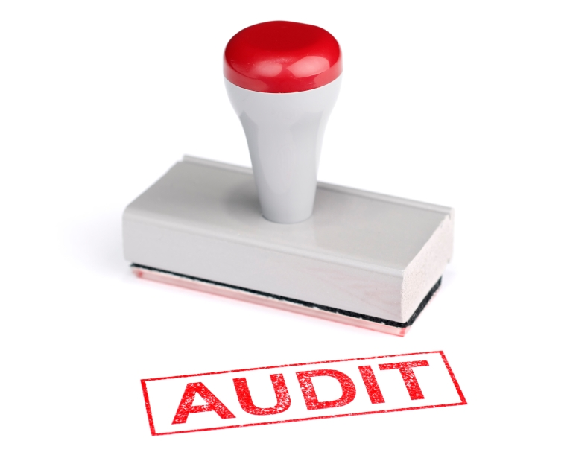
2. Application Scenarios
Check plant productivity based on production event logs (descriptive)
Improve support for high value customers in a customer service center (prescriptive)
Identify non-trivial cases of non-compliant behavior in finance services (predictive)
This Photo by Unknown Author is licensed under CC BY-ND
This Photo by Unknown Author is licensed under CC BY-SA
This Photo by Unknown Author is licensed under CC BY-SA

Slide 6
3. Training Exercise Goal
Define challenge
Prepare data
Analyze process
Go through complete data analysis process
Answer typical activity- & event-oriented queries
Understand role of PI in process management
See cloud-based process mining in action

Slide 7
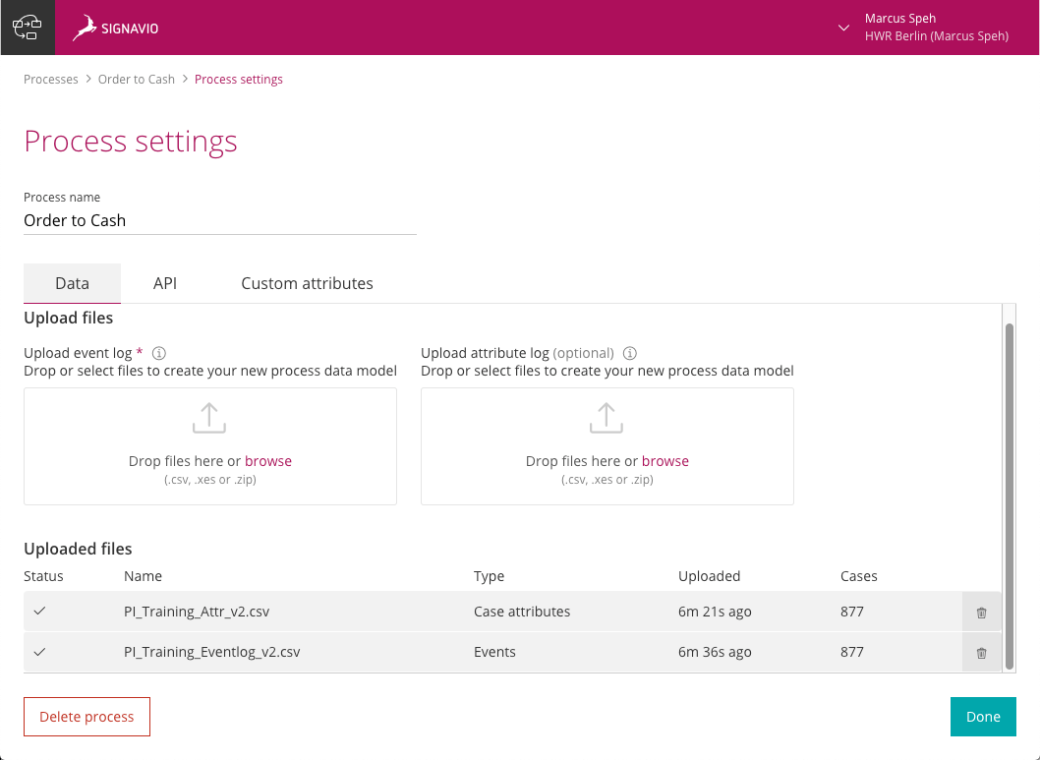
4. Training Preparation
Register & validate access to the Signavio® Process Manager Hub
Open the Process Intelligence dashboard
Enter a process name
Upload a process event log

Slide 8
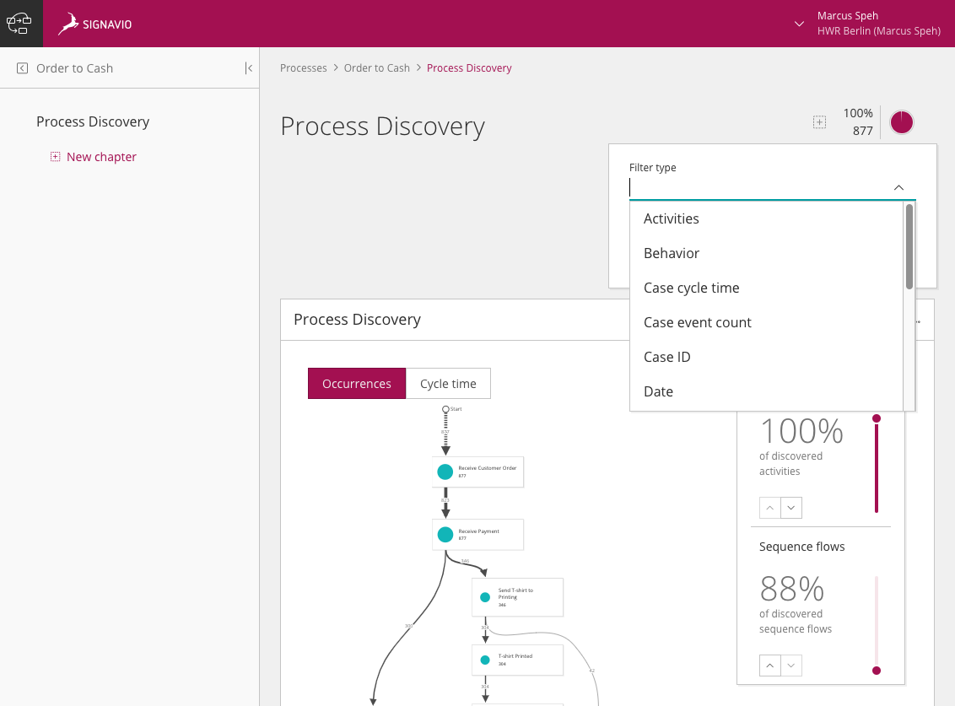
5. Signavio® PI, dashboard, chapter & filters

Slide 9
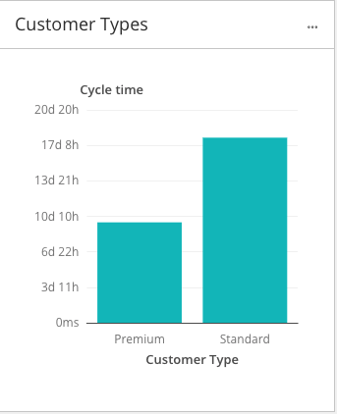
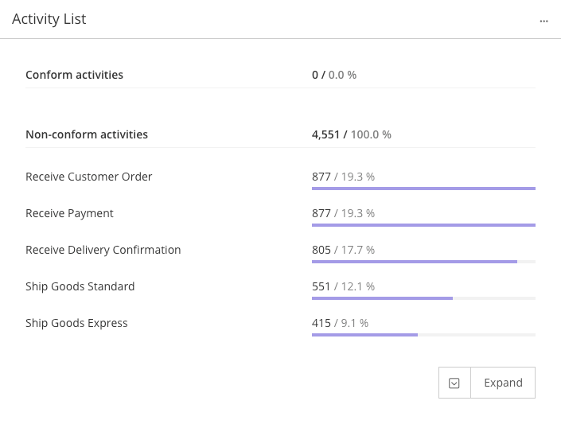
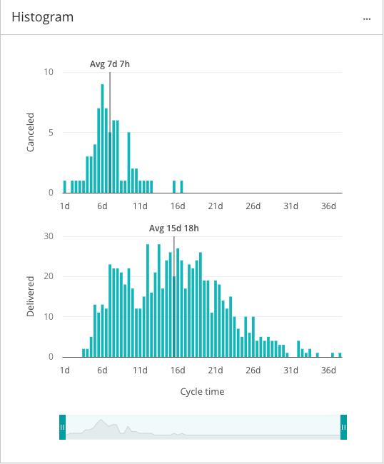
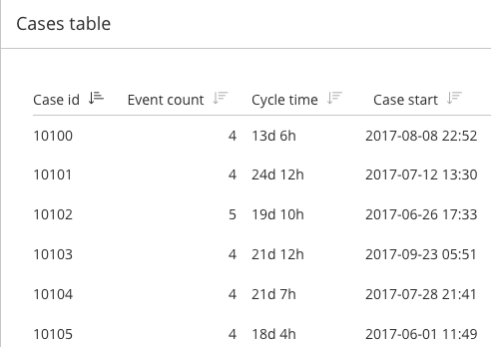
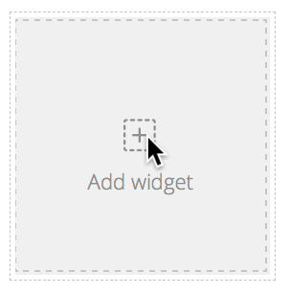
6. Widget types: - Activity List - Bar chart - Histogram - Cases table

Slide 10
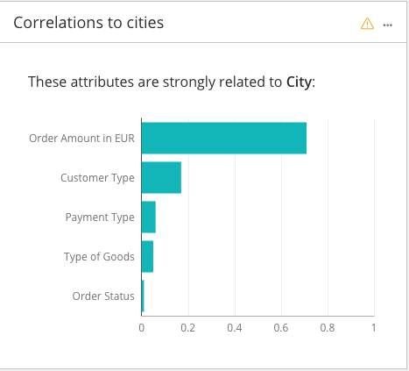
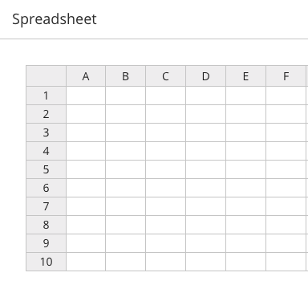

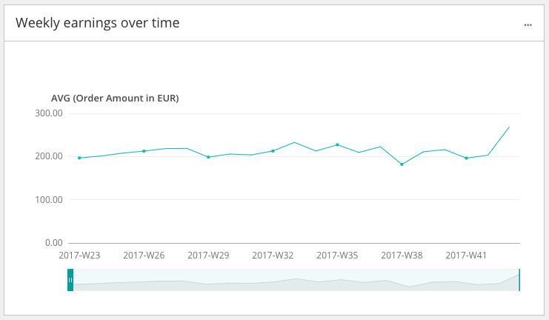
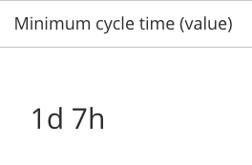
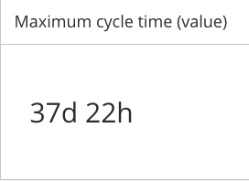
6. Widget types: - Variable importance - Value aggregator - Spreadsheet - Time series

Slide 11
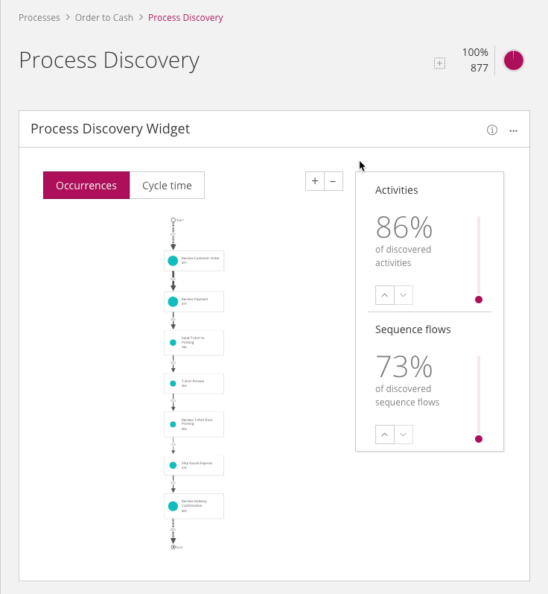
7. Process discovery
Default widget for new process
Generates process model from the event data using algorithms
Focus is on the sequence of activities (process-orientation)
You can filter on all existing attributes (based on log files)
Use sliders to change no. of activities/flows counted
Change between displaying occurrences vs. cycle time
Discover outliers, false starts/stops

Slide 12
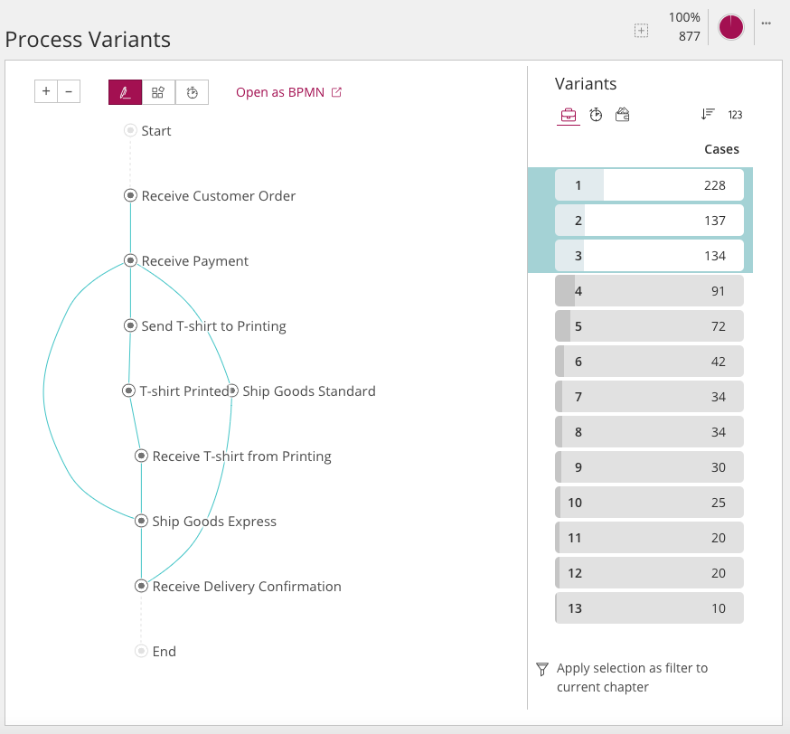
8. Process variants
Visualize process pathways (“variants”)
View pathways by occurrence or by duration (left hand side)
Sort by case log, duration or case attribute (right hand side)
Drill down by applying filters
Export selected variants as BPMN models to the process manager

Slide 13
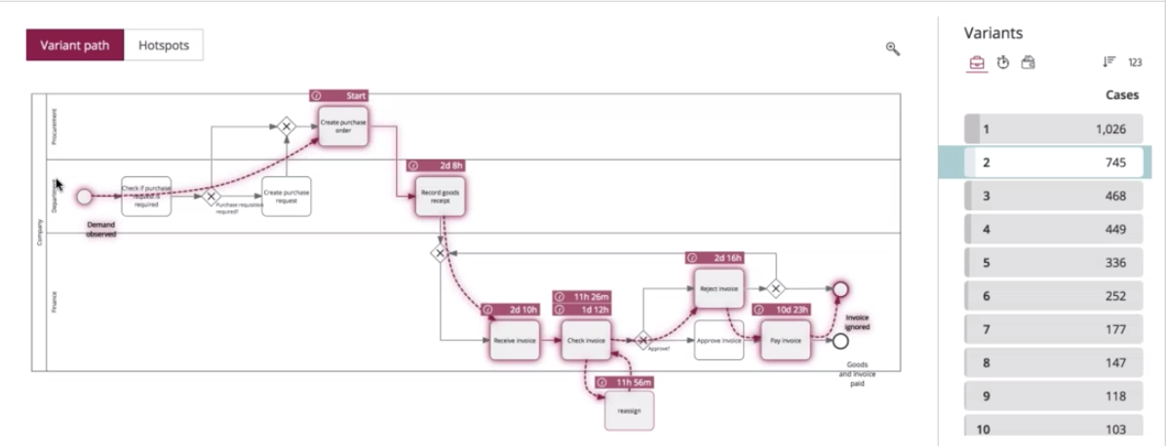



9. Process conformance / compliance
Activity bypassed
Unplanned activity
Source: Signavio® webinar process intelligence, 18th September 2018 (GERMAN only – makes sense to watch once you‘ve finished our training)

Slide 14
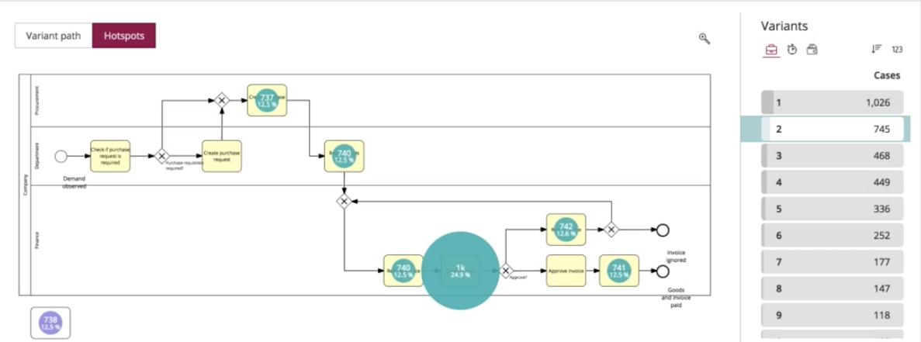
Hotspots
Source: Signavio® webinar process intelligence, 18th September 2018

Slide 15
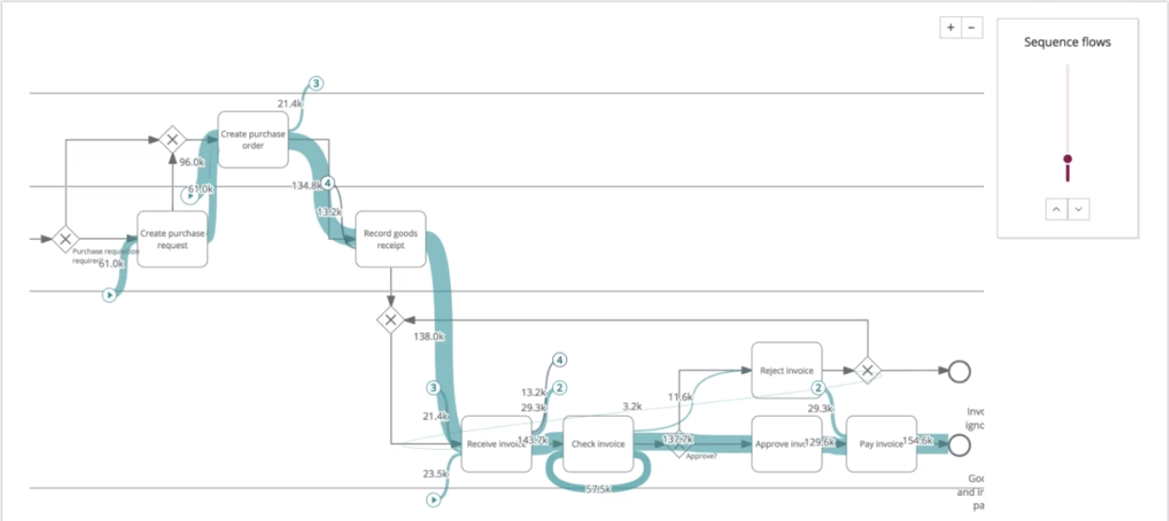
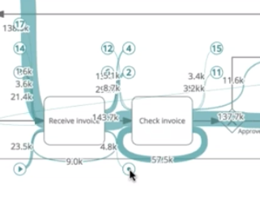
Process funnel view (Sankey diagram)
Non-scheduled process stop
Non-scheduled process start
Source: Signavio® webinar process intelligence, 18th September 2018

Slide 16
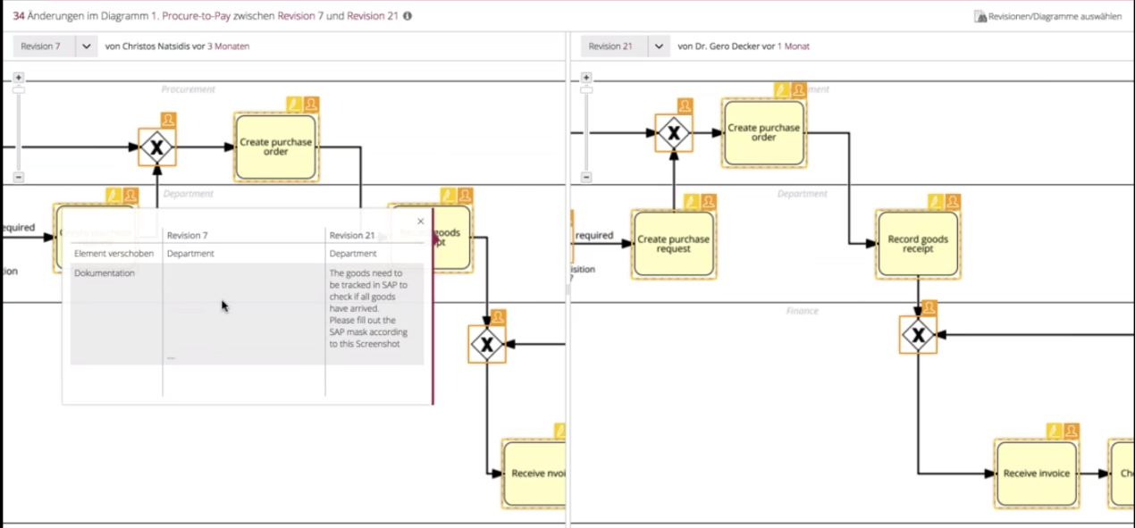

Diagram comparison (enhancement)
Check attributes (e.g. process roles)
Compare revisions & develop process
(distributed & in real time)
Source: Signavio® webinar process intelligence, 18th September 2018

Slide 17
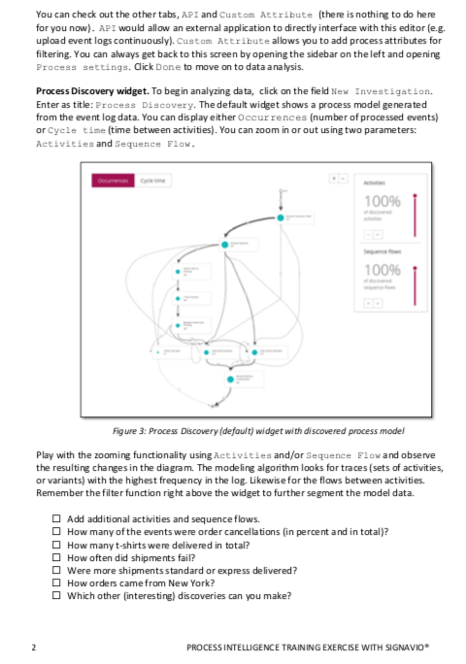
10. Practice Exercises
Simple Order-to-delivery process for practice
Data preparation: upload event log & attribute log files
Begin new investigation without existing BPMN model
Explore process using the Process Discovery Widget & filters
Explore other widgets to answer simple KPI questions
Explore process using the Process Variants Widget & animation
Export and import BPMN models
Look at the Process Conformance Widget.
Articulate questions throughout
Answer short UI survey

